Slide 1
Team Bruteforce
Case: Optimization
Created by: Sahil Karegaonkar, Christoffer Tryggestad, Skage Reistad, Sam Roupe and Sebastian Johansen

Slide 2
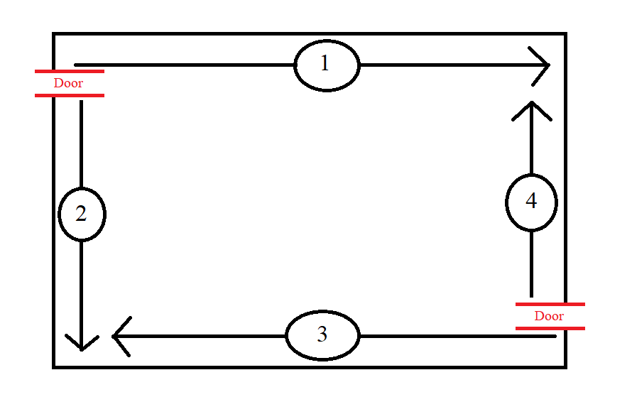
Concept:
Sort the list of rooms by size and type
Place the rooms in order away from the corners in the top-left and bottom-right. Create room for doors while doing so.
???

Slide 3
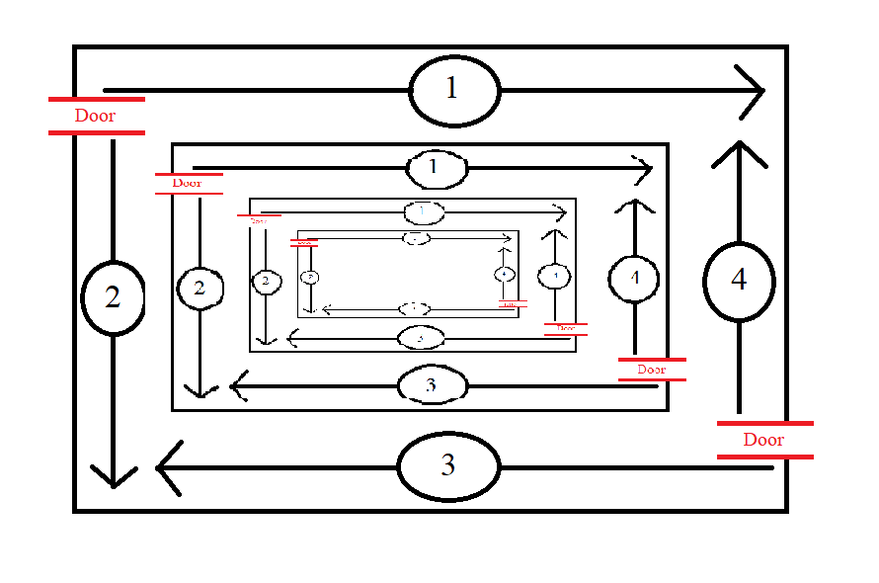
Concept:
Sort the list of rooms by size and type
Place the rooms in order away from the corners in the top-left and bottom-right. Create room for doors while doing so.
Iterate inwards
All rooms are always connected since we make room for doors at every iteration

Slide 4
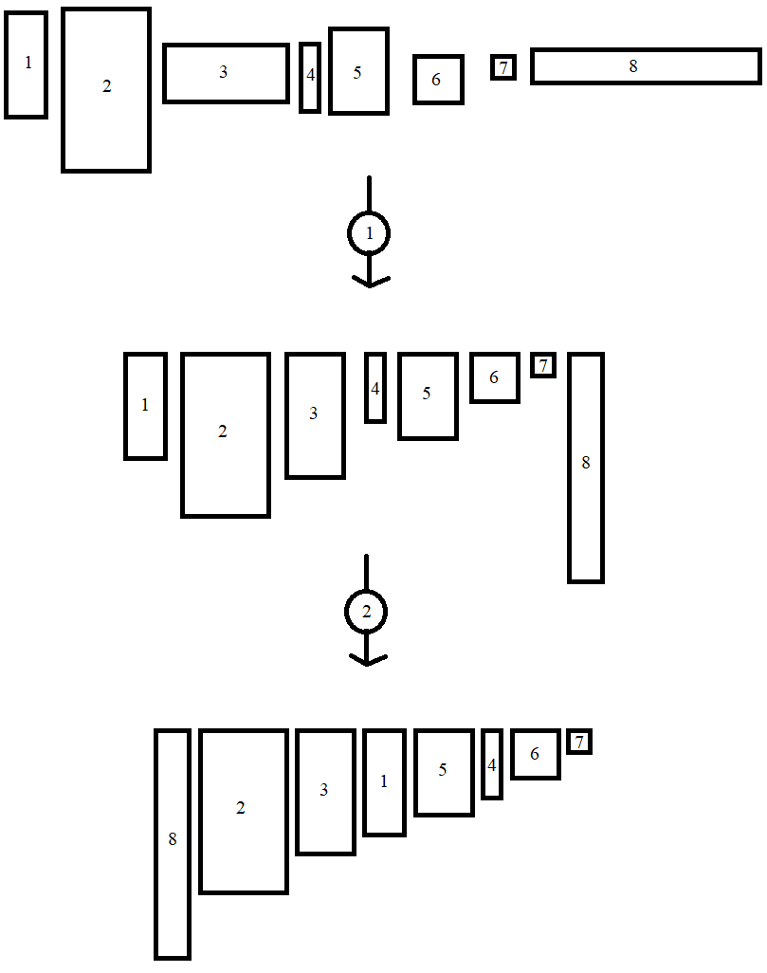
First sorting algorithm
All rooms are flipped so that their height is either larger or equal to their width
The rooms are then sorted by height

Slide 5
First placement algorithm

